Slide 1
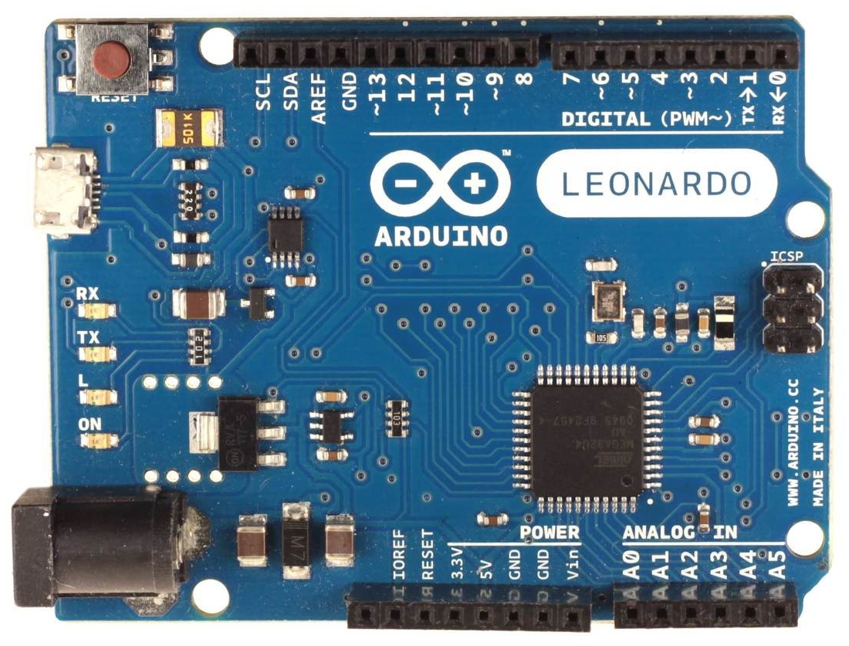
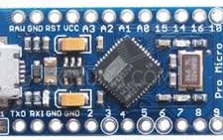
Arduino Leonardo FFB wheel fw-v18x pinout:
GND - common ground
5V - Vcc for all devices
A0 - throttle pot
A1 - brake pot (if LC - then clutch pot)
A2 - clutch pot (if LC - then handbrake pot)
A3 - handbrake pot (if LC - then button0)
A4, A5 - buttons 1,2 (fw-v180)
RX - channel A encoder
TX - channel B encoder
2 - channel Z encoder or SDA, data for i2C (ADS1105)
3 - SCL, clock for i2C (ADS1105)
4 - DT pin for HX711 (LC)
5 - CLK pin for HX711 (LC)
6 - DT_sw for shift register (if not then button4)
7 - CLK for shift register (if not then button5)
8 - PL for shift register (if not then button6)
9 - left PWM channel
10 - right PWM channel
11 - PWM direction pin
12 - button3
13 - FFB clipping LED
LC - load cell with HX711
Arduino Leonardo or Micro
To activate buttons
short them to gnd.
Arduino ProMicro
Replacement pinouts for ProMicro:
16 - PWM direction pin
3 - FFB clipping LED (if no ADS1105)
14 - button1 (fw-v180)
15 - button2 (fw-v180)
2 - button3 (if no ADS1105, fw-v180)
or Z-index encoder (fw-v180z)
Hat Switch (fw-v18x):
Button0 - up
Button1 - right
Button2 - down
Button3 - left

